Slide 1
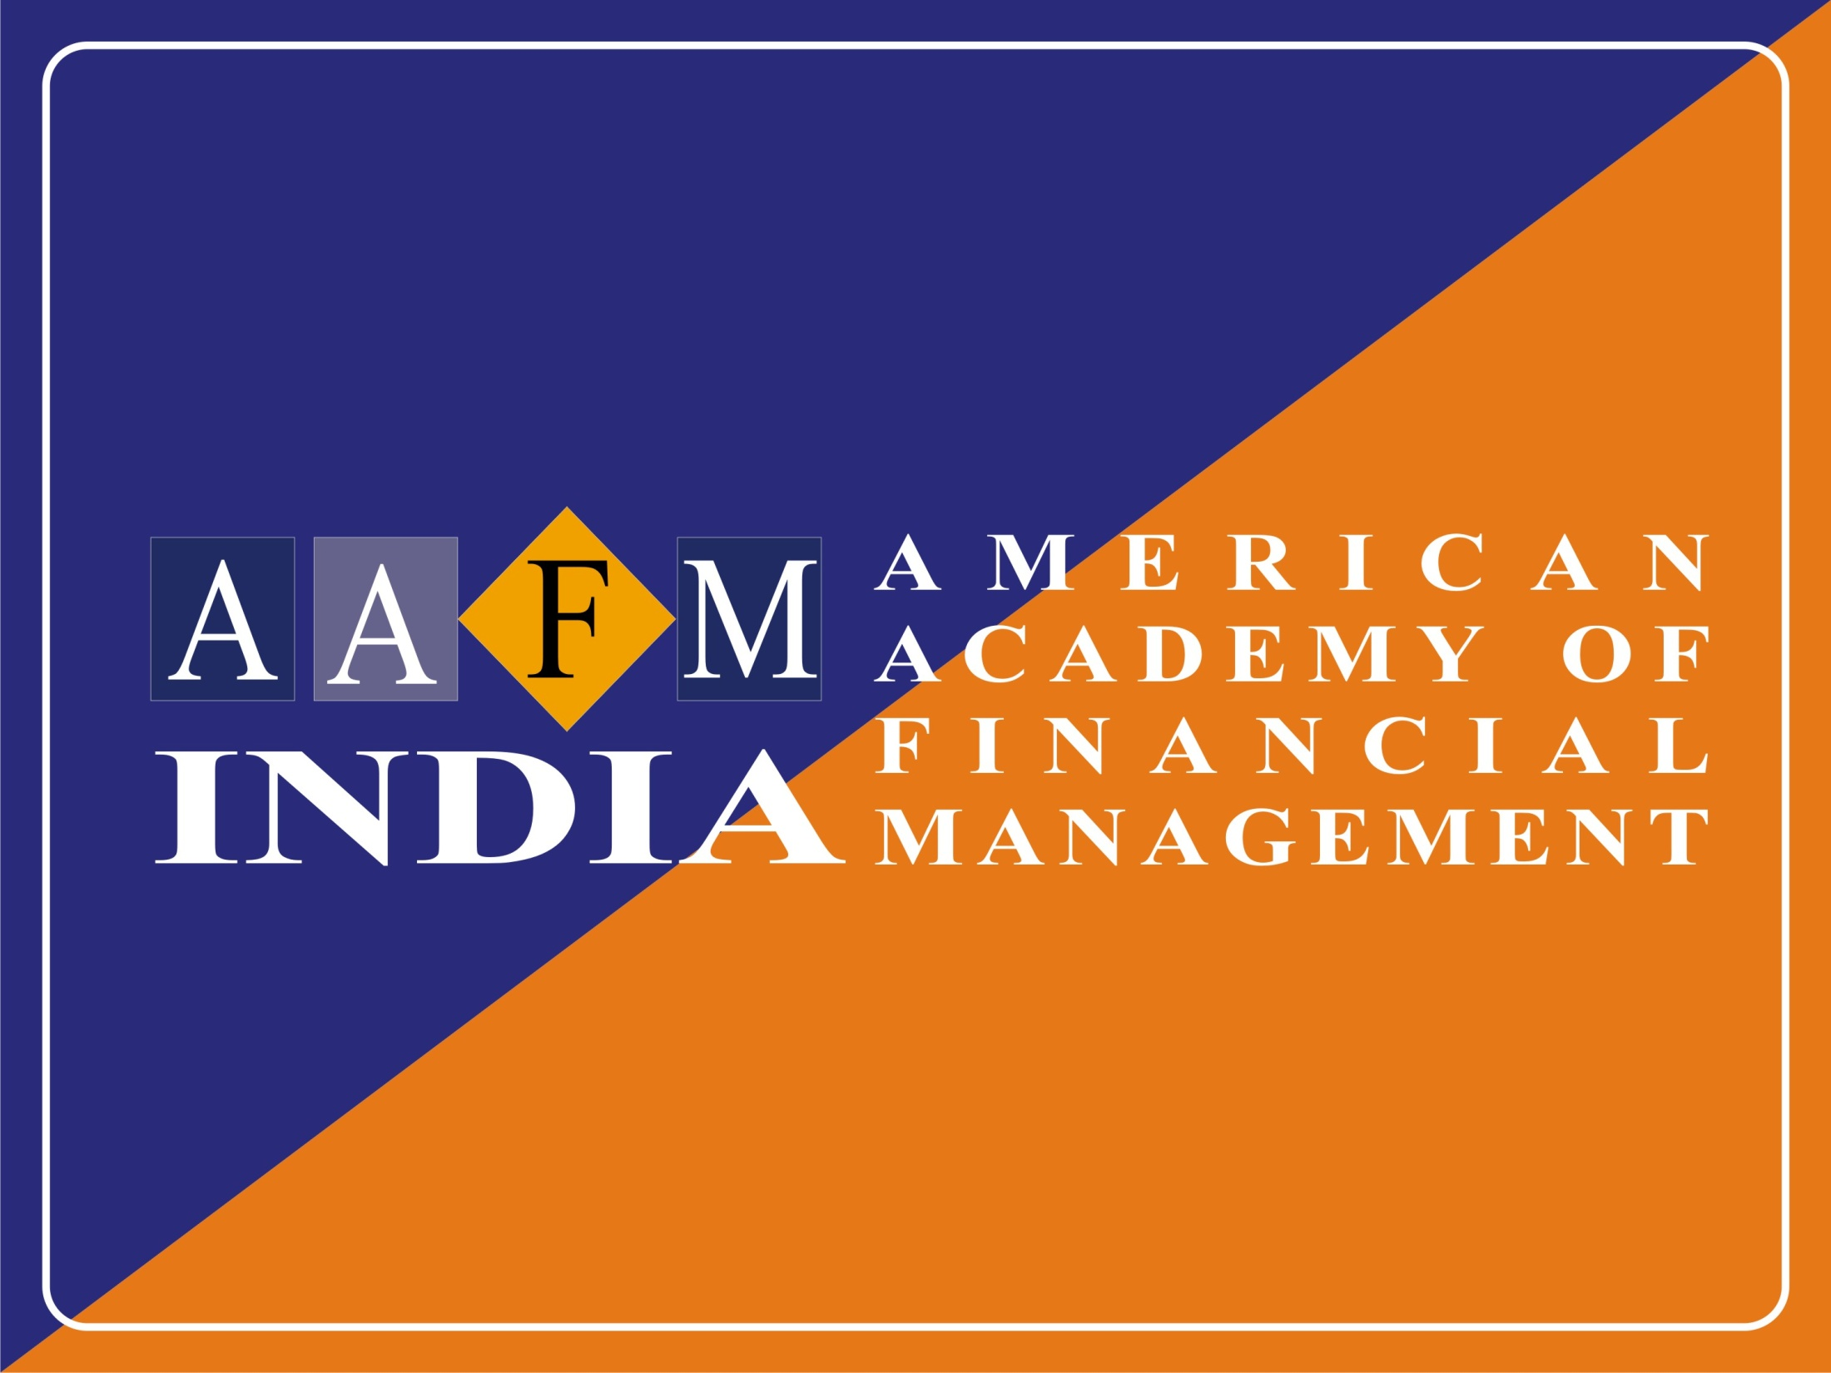

Slide 2



CHARTERED WEALTH MANAGER® (CWM®)
Presented by: Team AAFM India

Slide 3
Agenda
Today’s Presentation will provide insights on:
Overview of AAFM USA.
Chartered Wealth Manager® Credentials.
Assessment on the value of earning the CWM® Certification from different perspectives.
Identifying the CWM Examination Content.
Pathways for CWM® Registration.
Fee & Steps to Register
3
Notes:
Today’s presentation will:
Provide an overview of the Certified Treasury Professional credential
Assess the value of earning the CTP designation from different perspectives
Identify the CTP exam content
Review study resources

Slide 4
Flow of the Presentation
AAFM® as a Global Body
CWM® Certification
CWM Examination
AAFM India Board Fee
Mode of Registration for CWM®

Slide 5

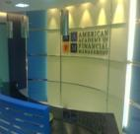


AAFM® as a Global Body
Background
Founded in Year 1996 – 18 Years Old Organization
Offices in 17 Countries like USA, UK, China, Hong Kong, Singapore, Taiwan, Dubai, Europe, India and more…….
Approx. 3,00,000 Certificants Globally and 50,000 CWM®
Members Present in 151+ Countries
Top 800 Business Schools Globally are now recognized and registered educational programs that qualify for educational credit for AAFM™ Membership

Slide 6
AAFM® as a Global Body
Credentials of the Institution
AACSB Accreditation (http://www.aacsb.edu/membership/MemberListings/corplist.asp)
ACBSP Accreditation (http://www.acbsp.org/p/cm/ld/fid=15)
Prof. G Mentz, Global CEO is a Distinguished Fellow of Royal Society of Fellows (http://royalfellows.org/id12.html)
Contributory Recognition by US Dept. of Labor in their Occupational Handbook (http://books.google.co.in/books?id=5oxGNtegbzsC&pg=PA105&dq=%22american+academy+of+financial+management%22+occupational+outlook&hl=en&ei=T9n7TPW8PIKsQPRnND2DQ&sa=X&oi=book_result&ct=result&redir_esc=y#v=onepage&q=%22american%20academy%20of%20financial%20management%22%20occupational%20outlook&f=false)
Top Designations in the USA in Forbes News (http://www.forbes.com/sites/investor/2011/07/05/how-to-check-out-your-stock-broker/3/)
AAFM India Tie-Up with BSE INDIA for conducting Financial Literacy Programs all across India
CWM Designation Recognized in WiseAdvisor.com http://www.wiseradvisor.com/designations-detail~id~45~des~chartered-wealth-manager-cwm.asp

Slide 7
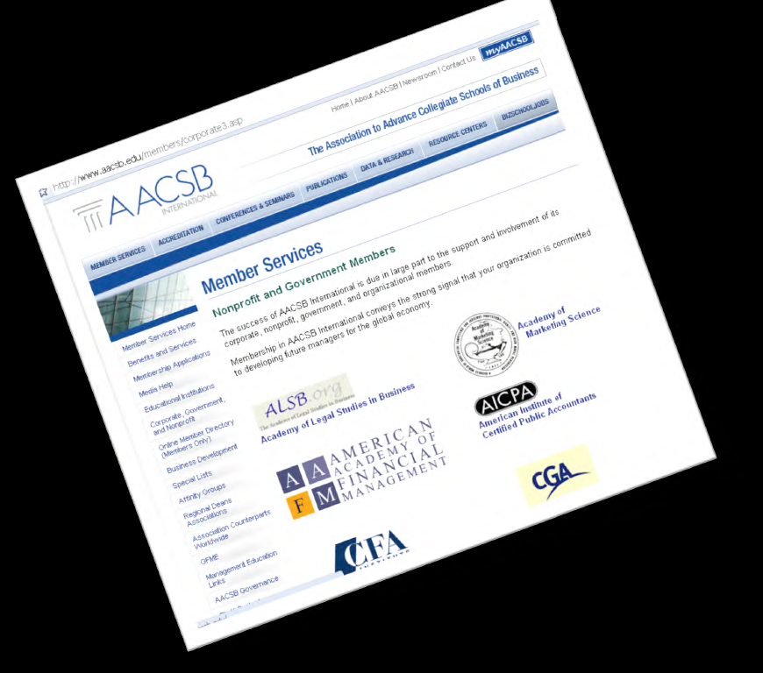
AACSB Accreditation

Slide 8
AAFM® as a Global Body
Credentials of the Institution
Top 10 Designations by WSG Include CWM® (http://www.wallstreetglobe.com/news.html)
NOCA ,National Organization for Competency Assurance - ICE - AAFM - IBS International Board of Standards is a: Certifying Organizational Member (http://www.credentialingexcellence.org/GeneralCertificationInfomation/MemberOrganizations/ICEOrganizationalMembers/tabid/68/Default.aspx)
Middle East Presence - AABFS Arab Academy of Banking and Financial Sciences (http://web.archive.org/web/20100204225548/http://www.aabfs.org/English/EnShowNews.asp?NewsID=749)
Financial Planning Standards Council (CFP Board of Canada) recognizes CWM® for CE Points (https://www.fpsc.ca/ce-course-providers)
ANSI American National Standards Institute - AAFM IBS International Board of Standards is a: Prof. Member (https://eseries.ansi.org/Source/directory/Search.cfm)
Many More Accreditations and Credential…

Slide 9

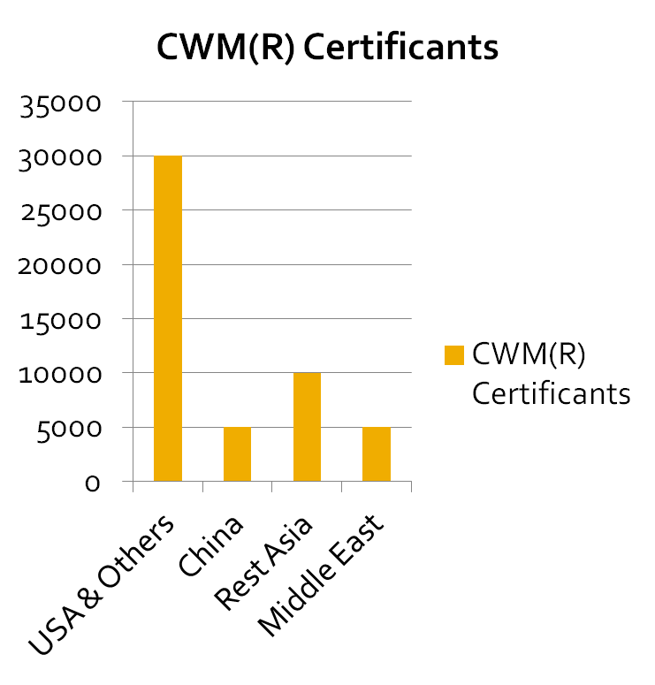
Global Presence
50,000+ Certificants across the Globe

Slide 10
AAFM @ Asian Financial Industry
AAFM® Asia has conducted In-house & Offsite Training for the following corporates
AIA Singapore – Life Insurance
ANZ Bank
ACE Insurance
Am Bank Group
American Chamber of Commerce
BNP Paribas
Bank Julius Baer
Bank of China
Bank of East Asia
Bank of New York
Bank of Singapore
Barclays Wealth
CIMB
China Everbright Bank
China Merchant Bank
Citibank
DBS
Goldman Sachs
Gulf Bank
HSBC
Hong Leong Bank
ING Fund Management
Prudential Asset Management
Prudential Assurance
Royal Bank of Scotland
Shanghai Pudong Development Bank
Singapore Exchange
Standard Chartered Bank
UBS
United Oversees Bank
Many More ……………

Slide 11
AAFM @ China Financial Industry
AIG
Bank of America
Citibank
HSBC
ING Life Insurance
Standard Chartered Bank
ABN Amro Bank
Bank BNP Paribas
Paris, France
CIGNA Group
American Healthy Life
Bank of America
Merrill Lynch
Morgan Stanley Securities
City commercial banks
New York Life International
The Bank of Communications (China)
Agricultural Bank (China)
Chinese Farmers Bank of Abu Dhabi
Commercial Bank India
Abu Dhabi Commercial Bank
Commercial Bank of Kuwait
Central Bank of the UAE United Arab Emirates
Central bank Everbright Bank
Huaxia Bank
CITIC Bank
Joint-stock banks

Slide 12
AAFM® @ Indian Financial Industry
Many Financial Services Organizations have joined AAFM as Corporate Members
These Corporate Members have agreed in writing to:
Promote CHARTERED WEALTH MANAGER® (CWM®) Certification at the organizational level by encouraging their employees to undergo the certification.
Recognize the CWM® Certification as an eligible advantageous qualification in the financial domain area in their organization.

Slide 13
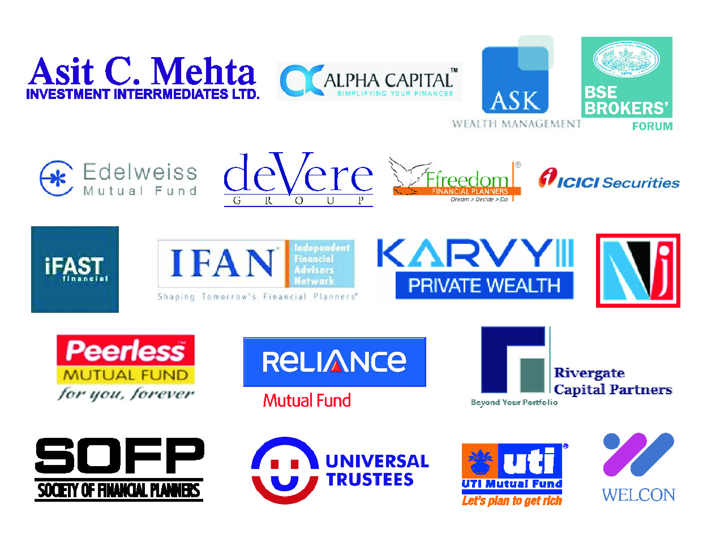
AAFM CORPORATE MEMBERS

Slide 14
Flow of the Presentation
AAFM® as a Global Body
CWM® Certification
CWM Examination
AAFM India Board Fee
Mode of Registration for CWM®

Slide 15
CHARTERED WEALTH MANAGER®
(CWM®)
Chartered Wealth Manager® (CWM®) is the Highest Global Designation in Wealth Management, Private Banking and Wealth Advisory.
CWM® are revered for their skills and expertise by Top Wealth Management Organizations across the Globe which give preference to CWM® Designation Holders in their recruitment process.

Slide 16
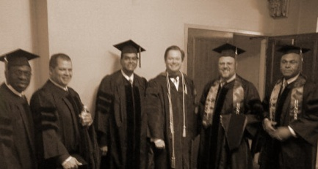
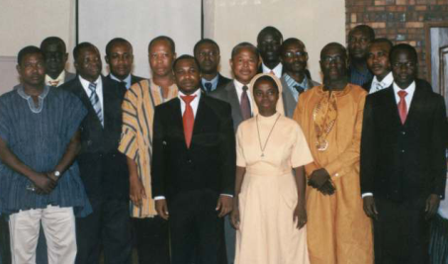



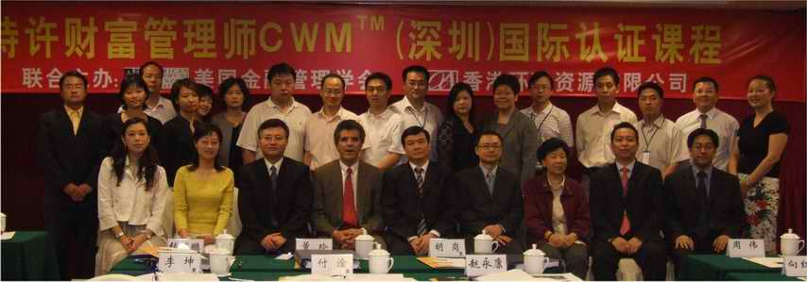


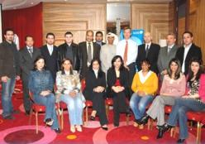
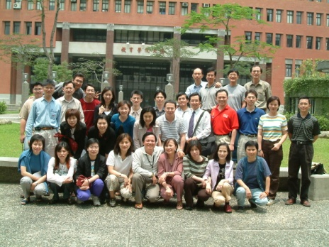
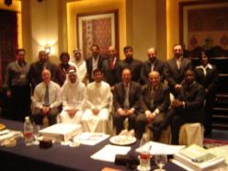
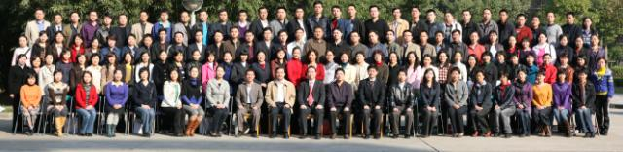
Global Presence - 150+ Countries & Truly
Global Since 1996…
Ghana, Africa
USA
Athens, Greece
Kuwait City
Hong Kong (SAR)
Doha, Qatar
Taipei, Taiwan
Dubai, UAE
Mainland - China

Slide 17
About CWM® Credentials
Awarded by the American Academy of Financial Management, USA (AAFM)
First given in 1996 – today more than 50,000 Financial Professionals have earned the credentials in 151+ countries.
5,500+ individuals register annually.
Eligibility Requirements:
  Minimum Graduation in any stream from a recognized body.
  Renewal Requirements:
  Earn ‘Continuous Professional Development’ points every year.

Slide 18
About CWM® Credential
The CWM® Designation sets the standard in the Wealth Management profession and is a symbol of excellence across the financial services industry fraternity worldwide.
It signifies that an individual has:
  Demonstrated the knowledge and skills required to perform competently in today's complex wealth advisory environment.
  Passed rigorous examinations.
  Agreed to abide by a professional Code of Ethical Conduct.
  Committed to keeping knowledge current by meeting “Continuing Professional Development” requirements.

Slide 19
Make a Mark with CWM®
1. Higher Salaries. Earn up to 26% more than your non-certified peers.
2. Increases Job Security. Validates your competency in liquidity, capital and risk management functions.
3. Better Career Flexibility. Prepares you for greater on-the-job responsibilities.
4. Improves Marketability. Stand out against other applicants in a tough job market.
5. Boosts Credibility. Attaining the Globally Coveted Designation helps in boosting your credibility.
6. Cutting Edge Skills and Knowledge: The knowledge and skills you gain on pursuing the program improves your on job performance.

Slide 20
The CWM® –
Impact on Compensation*
Select Job Titles with a CWM and No Advanced Degree*
Job Title % Salary Increase with CWM
Wealth Manager 23%
Relationship Manager 27%
Private Banker 19%
Average Amount Certified Incumbents Earn Over Uncertified Incumbents**
Job Category % Certification Increases Salary
Executive 7%
Management 11%
Staff 6%
Support 23%
*AAFM 2010 Compensation Report **AAFM 2011 Compensation Report

Slide 21
Employers Respect the Value of CWM® Certification
Valued and recognized by CEOs/Senior Executives in Wealth
Advisory and Private Banking and leading corporations as a
differentiator among current staff and potential new hires.
  82% of Top 500 Banks/ Wealth Management Organizations employ CWMs
  Wealth Advisory/Private Banking jobs require or prefer CWM
    Online job boards tracked include:
    Monster, eFinancialCareers.com, FINS, JobsintheMoney,
    CareerBuilder, AAFM Global Career Center

Slide 22
Curriculum of CWM® Certification
LEVEL -I
LEVEL- II
UNITS | NAME OF UNIT
Unit 1 | Concept of Wealth Management
Unit 2 | Indian and Global Financial System
Unit 3 | Measuring Investment Returns in Wealth Management
Unit 4 | Managing Investment Risk in Wealth Management
Unit 5 | Investment Vehicles of Wealth Management
Unit 6 | Role of Wealth Management In Banking
Unit 7 | Legalities in Wealth Management
Unit 8 | Tax Laws for Wealth Management
Unit 9 | Life Cycle Management
Unit 10 | Intergenerational Wealth Transfer & Tax Planning
UNITS | NAME OF UNIT
Unit 1 | Equity Analysis
Unit 2 | Alternate Products in Wealth Management
Unit 3 | Behavioral Finance in Wealth Management
Unit 4 | Real Estate Valuation and Analysis
Unit 5 | Loan & Debt Management
Unit 6 | Portfolio Management Strategies
Unit 7 | Relationship Management by a Wealth Manager
Unit 8 | INTERNATIONAL TAXATION AND TRUST PLANNING
Unit 9 | WEALTH MANAGEMENT PLANNING
Unit 10 | ADVANCED WEALTH MANAGEMENT

Slide 23
Key Learnings
Explore the latest advances in Wealth Management strategy and law.
Expand your Wealth Management skills by adopting International best practices.
Develop a checklist of key Applied Techniques in Wealth Management that will remain with you throughout your career.
Become an Expert in Evaluation, Diagnosis and Planning in catering High Net Worth & ultra High Net Worth Clients long with managing Middle Class & Upper Middle Class.
Integrate optimum combination of best suited products and services in your Wealth Management development strategies.
Maximize the impact of your client communications and reporting.
Appreciate the complexities of investing in global markets and develop strategies for managing risk and thereby maximizing returns.

Slide 24
Key Highlights of CWM®
Chartered wealth manager® (CWM®)
Designed and developed by Global Academicians and Industry experts :Global + Indian Content
Focus on Wealth Management and Financial Advisory Services Industry.
Time Commitment – 6 Months
Key Topics Covered:
  Global Financial System
  Relationship Management
  Behavioral Finance
  Derivatives
  Equity Analysis & PMS
  Real Estate Valuation
  Loan & Debt Management
  Intergenerational Wealth Transfer
  International Taxation

Slide 25

Scenario of Wealth Management In India
We are witnessing a very exciting phase in the financial services sector and I believe that this phase is here to stay, which will eventually change the way financial services business is conducted in the Indian subcontinent.
India as an economy has embarked on a high growth trajectory which results in higher GDP with higher disposable income in the hands of individuals. This, coupled with India's growing interaction with developed nations, has exposed Indians to global financial service standards. These and many more favorable factors have given rise to an untiring demand for specialised financial services which match the growing aspirations of young & emerging India
CWM® certification has emerged as a respected standard to justify an individual's proficiency in understanding Wealth Management Services and render world class Wealth Management Solutions to affluent clients with the highest standards of integrity.
Anup Bagchi
MD & CEO
ICICI Securities Ltd.
Source: ICFL Customer Presentation

Slide 26

Scenario of Wealth Management In India
The cornerstone of a successful Wealth Management firm is the confidence it earns from its clients. These clients entrust their financial desires and aspirations with the firm through professional Wealth Managers representing the firm. It is imperative that the Wealth Managers should have highest levels of professional integrity backed by a deep understanding of investment solutions that cater to the exclusive needs of affluent individuals.
CWM® certification reinforces the high competency levels of Wealth Managers and hence is fast gaining acceptance as a preferred certification amongst many reputed Wealth Management firms.
Ashish Kehair
EVP & Head-Wealth
Mgmt.
ICICI Securities Ltd.
Source: ICFL Customer Presentation
Notes:
26

Slide 27
About CWM® Examination
2 Examinations : Compulsory Pathway- Level 1 & Level 2 Exams & Experience Pathway – only Level 2 Exam.
Standardized test randomly administered with pool of over 2000 Question Bank.
Instantaneous Pass/Fail Results.
Delivered via a computer (5,000+ Pearson VUE Centers worldwide)
Level 1 Exam: 55 Questions, 115 Minutes, 100 Marks, 50% Passing & No Negative Marking.
Level 2 Exam: 85 Questions, 175 Minutes, 160 Marks, 50% Passing & No Negative Marking.

Slide 28
CWM® Exam
Exam Name | Units Tested | Centres | Exam Date | Exam Language | Duration | Exam Fees | Enrolment Through | Compulsory Pathway | Experience Pathway
CWM Level-I | 1-10 | Pearson Vue Centres Globally | 10th to 20th of every Month | English | 115 Minutes | Rs.2247.20 | Enrolment through AAFM Website and scheduling Through Pearson Vue pearsonvue.com | yes | No
CWM Level-II | 11-20 & 20% from unit 1-10 | Pearson Vue Centres Globally | 10th to 20th of every Month | English | 175 Minutes | Rs.3370.00 | Enrolment through AAFM Website and scheduling Through Pearson Vue pearsonvue.com | yes | yes

Slide 29
Popular Prep Tips from Exam Takers
Prepare properly, thoroughly, systematically
Commit to study time: Create a Study Plan and stick to it!
Find a study-buddy
Create a study spreadsheet for all the formulas used
Record notes onto an iPod and listened to them constantly
Completely understand and be able to apply concepts and formulas
Practice working through all the calculations forward and backward, changing the solve for variable
Make flashcards with Q&A for each chapter as you go along
Practice, Practice, Practice!
Notes:
Prepare properly, thoroughly, systematically
Commit to study time: create a study plan and stick to it!
Find a study-buddy
Create a study spreadsheet of all of the formulas
Record notes onto an iPod and listened to them constantly
Completely understand and be able to apply concepts and formulas
Practice working through all the calculations forward and backward, changing the solve-for variable
Make flashcards with Q&A for each chapter as you go along
Practice, practice, practice!

Slide 30
Flow of the Presentation
AAFM® as a Global Body
CWM® Certification
CWM Examination
AAFM India Board Fee
Mode of Registration for CWM®

Slide 31
AAFM India Board Fee**
Compulsory Pathway –
Rs. 10,000/ (Registration)- plus Rs. 6,000/- (Courseware) plus Rs. 5,000/- (Examination) = Rs. 21,000/-
Experience Pathway –
Rs. 10,000/ (Registration)- plus Rs. 6,000/- (Courseware) plus Rs. 3,000/- (Examination) = Rs. 19,000/- . Level 1 Examination is exempted
Special Fee structure for Corporate Member of Rs. 11,000/- includes Registration Fee and Study Material Fee
Certification Fee –
100 USD
** Service Tax Extra on all above fees.

Slide 32
Flow of the Presentation
AAFM® as a Global Body
CWM® Certification
CWM Examination
AAFM India Board Fee
Registration for CWM®

Slide 33
Mode of Registration for CWM®
Compulsory Pathway : The eligibility criterion to register for the CWM certification through Compulsory Pathway is that the candidate must have passed minimum 12th Standard but minimum a graduate to hold the certification.
Experience Pathway : The eligibility criterion to register for the CWM certification through Experience Pathway is that the candidate must have passed Graduation with 3 years of minimum work experience.
Registration can be done only through Authorized Education Providers

Slide 34
How to Register?
Log On to : http://www.aafmindia.co.in/Certifications/StudentRegistration.aspx
Fill the Registration Form and Pay the Fees:
Need to fill the registration form and pay the fees online or offline.
Your Email Id becomes the Log In ID for the AAFM Student Account.
You are required to upload a recent Passport Size Photograph.
Fee Payment Options
You can pay the Program Fees Online through Payment Gateway by Credit Card or Debit Card.
OR
Offline through Demand Draft Payable to ‘American Academy of Financial Management India Private Limited’

Slide 35
AAFM Key Members
For Admissions:
info@aafmindia.co.in
91-11 45120800, 43607455
Deepak Jain, CWM
Country Head
Knowledge Management
91 9811033215
deepak@aafmindia.co.in
Dimple Mittal
Regional Head-Admissions
91 9650159583
dimple@aafmindia.co.in
Vyas Rai Nagpal, CWM
Country Head-Marketing
91 9711797800
vyas@aafmindia.co.in
Tanu Chugh
Manager-Operations
91 11 45120800
operation@aafmindia.co.in

Slide 36

GET WEALTH MANAGEMENT’S HIGHEST DESIGNATION
Deepak Jain
Country Head
American Academy of Financial Management India
(M): +91 9811033215; Email ID: deepak@aafmindia.co.in
BUILDING WEALTH MANAGERS OF TOMORROW

